Slide 1

Welcome to our Total Joint Preparation Class
What You Can Expect…
Presentations by:
Nurse Navigator: Ashley Rice, RN
Phone: 802-251-8418
BMH Physical Therapy: Kailey Crowell, DPT
Notes:
Hello… welcome to our virtual Total Joint Class. In this presentation we are going to briefly walk you through the Total Joint Replacement process from pre-op through post-op. If at the end of this presentation you have any questions please call the Ortho Clinical Supervisor, Jennifer Carpenter at (802)251-8643. Enjoy!

Slide 2
Preoperative Checklist
At the Pre-op Clinic visit you will have a nursing assessment done by an RN
Have a list of ALL medications including vitamins and supplements
Be prepared to review your Medical/Surgical/Social History
Lab work and other necessary testing such as an EKG will be discussed and ordered if needed
Notes:
Currently a majority of the pre-op clinic visit is being done over the phone. The nurse will be reviewing your current home medications, including vitamins and supplements. The nurse will instruct you on which medications will need to be stopped before surgery and when they will need to be stopped. Your medical, surgical, and social history will be reviewed and updated in your medical record. The pre-op nurse will discuss with you the necessary lab work, EKG, and COVID test that will need to be completed before surgery, they will let you know when they will be scheduled.

Slide 3
Preoperative Nurse Educators
Preoperative Clinic Nurses: 802-257-8866
Moriah Aldrich, RN, BSN
Pernille Stage, RN
*call for questions regarding which medications to take and those to hold ahead of surgery
Notes:
If you have not been contacted by the pre-op clinic already you will be shortly. The pre-op clinic nurses and staff will be working with you over the phone to prepare you for your joint replacement surgery. You will likely be asked to come in for some additional testing.

Slide 4
Preoperative Rules
Do not shave your legs and do not cut your toenails within 7 days of surgery if you are having a knee or hip replacement
Do not shave your axilla (armpit) within 7 days if having a shoulder replacement
No creams or lotions on surgery day. No deodorant on day of surgery if having a shoulder replacement
No nail polish on fingers or toes or artificial nails – must be removed before surgery
No jewelry or piercings allowed in the OR- this includes wedding rings
Notes:
If you are having knee or hip surgery please do not shave your legs and do not cut your toenails within 7 days of surgery. If you are having your shoulder replaced please do not shave under your arm within 7 days of surgery. Protect your operative arm or leg prior to surgery, if you have any cuts or scratches your surgery may need to be rescheduled. Cuts and scratches could increase your risk of developing a post-operative infection. At BMH we are extremely proud of our low post-operative infection rates, protecting your operative arm or leg before and after surgery is just one way that we are able to achieve it.
Please do not apply any creams, lotions, or deodorants on your day of surgery. No nail polish on fingers or toes. No artificial nails, please have them removed prior to your surgery. No jewelry or piercings of any kind are allowed into the OR – this does include wedding rings. We can not make exceptions! The no jewelry policy is another way that we keep the infection rates low. In addition, at times in the OR they need to use cautery and any metal (jewelry) on your person puts you at risk for a skin burn.
Please leave all valuables at home – bring with you a photo ID and insurance card to ease with registration on day of surgery. In a few slides I will talk a little more about things to pack to make your stay more pleasurable.

Slide 5
Fasting Guidelines
In order to safely receive anesthesia, your stomach must be as empty as possible prior to surgery (regardless of the type of surgery or anesthesia you will be receiving). Otherwise, there is a risk of choking during surgery.
Your safety is our highest priority and we require that you follow these rules:
You may have ONLY WATER on the day of surgery, up until 2 hours prior to your scheduled arrival time at BMH
Absolutely no other food or drink after midnight before the surgery or your surgery will be postponed including gum, breath mints, or candy
Medications that you have been told to take on the morning of surgery may be taken with sips of water.
You may brush your teeth with sips of water
Notes:
Please review our fasting guidelines as they are very important to us and your safety. You may have water and water only up until 2 hours prior to your scheduled arrival time at BMH. Medications that you have been told to take on the morning of surgery may be taken with sips of water. Absolutely no other food or drink after midnight before the surgery or your surgery will be postponed or possibly have to be rescheduled. No gum, breath mints, or candy allowed after midnight. You may brush your teeth with sips of water on the morning of your scheduled surgery.

Slide 6
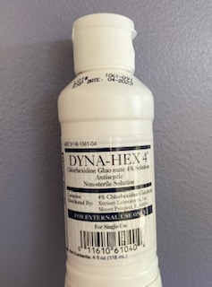
Prevention of Skin Infections
Dyna-Hex 4 Antiseptic Soap is used to reduce your risk of a surgical site infection
Use the night before and the morning of surgery as instructed
Dyna-Hex 4 Antiseptic Soap is alcohol-free and skin-friendly. Apply to your washcloth as needed to cover all body surfaces, wait two minutes and rinse. Avoid contact with the face, ears, and genital/anal areas.
Notes:
Another thing that is done to reduce your risk of developing an infection is the use of Dyna-Hex 4 antiseptic soap. It is to be used the night before and the morning of surgery. The soap is alcohol-free and skin friendly. Perform your normal showering routine with hair washing and rinsing. Then with your water shut off apply the antiseptic soap to your wash cloth as needed to cover all body surfaces; avoiding face, ears, and genital/anal areas. Wait 2 minutes with the water off and then rinse. It is also recommended that you use a fresh clean towel, have clean linens on your bed, and clean nightwear.

Slide 7
MRSA/MSSA Positive
Nasal swab obtained in Orthopedic office or in pre-op clinic
You will be notified by the Pre-Op Clinic RN if you have a positive MRSA/MSSA culture and you will need to use your Dyna-Hex 4 wash for 5 days prior to your surgery.
You will also be given a prescription for an ointment (Bactroban) to be applied inside your nose.
Notes:
When you were in the Orthopaedic office you likely had the inside of your nose swabbed to check for the presence of MRSA/MSSA, a particular bacteria that would need to be treated prior to surgery. If the swab comes back positive the pre-op clinic will let you know and discuss the next steps. This would include using the Dyna-Hex 4 soap for 5 days prior to surgery and applying a prescription ointment to the inside of your nose prior to surgery. If you hear nothing more about it, then it is nothing to worry about.

Slide 8
What do I pack in my suitcase?
Loose, comfortable clothes
Oral hygiene supplies
Cell phone w/ charger, tablets, laptops
Comb/brush
Personal care items (i.e. deodorant)
C-PAP machine, if applicable
You do not need to bring distilled water to the hospital
Notes:
When packing your suitcase it is best to pack loose, comfortable clothing. Something that will fit comfortably over your incision and is easy to put on. Bring your own personal care items such as tooth brush, tooth paste, comb/brush, deodorant. If you use a C-PAP machine at home please bring it with you, you will not need the distilled water as the hospital will supply it. For entertainment or distraction you can bring electronic devices (you will be able to access the BMH guest Wi-Fi), books, crosswords…

Slide 9
Day of Surgery Arrival Time
To obtain your arrival time, call 802-257-8328 the day prior to surgery between 1 and 2 p.m.
The arrival times for Total Joint patients are 6:00 a.m., 7:15 a.m.,9:30 a.m.
If your surgery is on Monday or after a holiday weekend, call the Friday before surgery
If you are unavailable to call at this time, the hospital will call and leave a voicemail with your arrival time
Notes:
To find out what time you need to arrive on your day of surgery please call (802)257-8328 the day before surgery between 1 and 2 PM. The surgery times are not determined until the day before surgery. The typical arrival times for total joint patients are 6:00 am, 7:15 am, and 9:30 am. If your surgery is on a Monday or before a holiday weekend, please call the Friday before your surgery. If your surgery is on the day after a holiday that falls during the week, call 2 days before your surgery.

Slide 10
Morning of Surgery
Come in the Main Entrance of the hospital, you will register on your right at Patient Registration
It is ok to leave valuables at home however you MUST bring in both your photo ID and insurance card
You will then be guided to the 2nd floor
Admission routine with your 2nd floor nurse begins. Additional labs will be completed, if needed.
Family is allowed to accompany you to the 2nd floor on the morning of surgery
Notes:
On the morning of surgery you will enter through the main entrance of the hospital. You will be screened upon entry and will then need to proceed to registration. Once registered you will be directed to the 2nd floor, our surgical floor. The rooms on 2nd are all private with their own bathroom and shower. You will be able to put your personal belongings away before beginning the admission routine with the 2nd floor staff. You will be asked to change into a lovely hospital gown and given grip socks. You will be asked to share your name and date of birth, allergies will be checked and your home medications will be checked including when you last took each one. An IV will be started and you will be given some oral medications that have been ordered by your surgeon and anesthesiologist.

Slide 11
Morning of Surgery continued…
When you are ready for surgery you will be brought to the post-anesthesia care unit (PACU) in your hospital bed. Family can accompany you to the PACU, however, family may not be allowed into the PACU depending on patient census
Here you will meet with the surgeon one more time ahead of surgery
You will also meet with your Anesthesia provider to:
Discuss anesthesia options
Have any of your questions and concerns addressed
Reach an agreement
Sign consent for anesthesia
Notes:
Once you are ready for surgery you will be transported in your hospital bed down to the post-anesthesia care unit (PACU). While in the PACU awaiting your surgery you will again meet with your surgeon, they will be able to answer any additional questions that you have and will be marking your surgical site. You will also meet with your anesthesiologist to discuss the planned anesthesia, have questions answered, and sign consent for anesthesia.

Slide 12
Anesthesia
Types of anesthesia
IV Sedation
Spinal – most often used for total knees & total hips
General – total shoulders
In addition, knee replacement patients will have the IOVERA nerve block, an adductor canal block (regional block), as well as a peri-articular block in OR
Notes:
All patients will receive some local anesthesia with sedation to help you relax. Total shoulder patients will be done under general anesthesia – this means you will have a breathing tube, you will be kept completely unconscious and pain-free during the entire procedure. Shoulder patients will be given a peripheral nerve block in addition to the general anesthesia. This is an injection of anesthetic around a specific nerve or group of nerves, done for post-operative pain control. Total and partial knee and total hip patients will be given spinal anesthesia – this is an injection of anesthetic near, but not into, the spinal cord and the nerves that connect it, it blocks pain from the waist down. Total and partial knee patients will also be given a peripheral nerve block. Much like the peripheral nerve block for the shoulder it is an injection of anesthetic around a specific nerve or group of nerves and is done for post-operative pain control.
Although your anesthesiologist already has an idea in mind for how to proceed safely with your anesthesia and surgery, it is always a conversation and if you have any questions or concerns they will be heard.

Slide 13
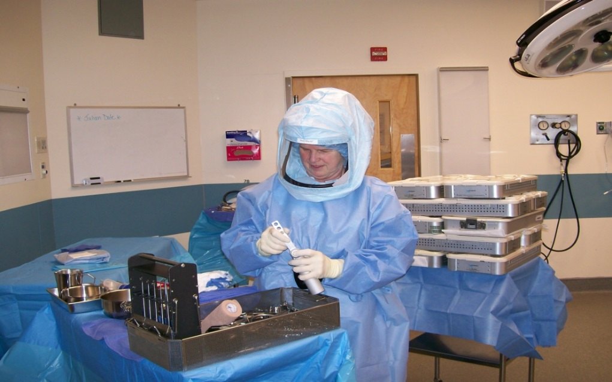
Operating Room
Greeted by the O.R. staff
Brrrrrrrr! It’s cold in here
All the blue is the sterile field
Time:
Total Shoulders are approximately 1 ½ -2 hours
Total Hips approximately 1 ½ -2 hours
Total and Partial Knees is approximately 1 – 1 ½ hours
Notes:
Once fully prepared for surgery you will be transported to the operating room in your hospital bed. You will be assisted onto the OR bed and made comfortable prior to your spinal placement. It is quite cold in the Operating Room, we will make sure to place nice warm blankets on you once positioned properly. You will be greeted in the Operating Room by the Surgical Assist, dressed here in the blue “Space Suit”, and all other members of your surgical team.
Surgery time for:
Total Shoulders is approximately 1 ½ -2 hours
Total Hips approximately 1 ½ -2 hours
Total and Partial Knees is approximately 1 – 1 ½ hours

Slide 14
Post Anesthesia Care Unit - PACU
Arrive to PACU in hospital bed after surgery is completed
Oxygen, TED stockings, SCD’s on
Blood Pressure Cuff & Pulse Oximeter
IV Fluids
B/P, heart rate, breathing monitored at least every 15 minutes
Pain assessed and medication given as ordered
Notes:
After your surgery you will be carefully moved back into your hospital bed by your Operating Room team and transported back to the Post Anesthesia Care Unit (PACU). As you are waking up you will notice that you have many devices connected to you helping the team to provide good care. You will likely have Oxygen in your nose, Sequential Compression Devices (SCDs) on your lower legs gently squeezing your calves to decrease your risk of developing a blood clot, a blood pressure cuff and finger pulse oximeter, and IV fluids connected keeping you hydrated.

Slide 15
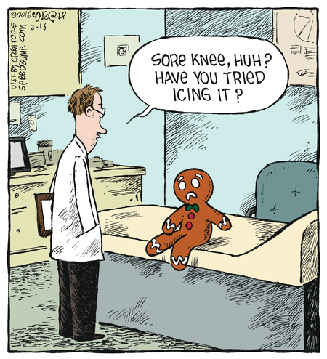
Transfer to Surgical Floor
Transfer to surgical floor in hospital bed
Orientation to room
Call bell
Vital signs
IV fluids
Family may visit with you at this time
Notes:
Once stable you will be transferred in your hospital bed up to the post-op surgical floor for the remainder of your stay. Once back in your room you will again be connected to a machine for frequent vital signs monitoring and to an IV pump to give you fluids. You will be given a call bell and instructions on how to use it, please call for any and all assistance that you need.

Slide 16

Preventing Complications
Pain
Nausea
Falls
Infection
Blood Clots
Constipation
Pneumonia
Notes:
In the next few slides we will discuss many of the things that we do to prevent possible complications.

Slide 17
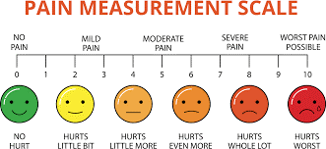

Pain Management
Pain Scale
Oral/Intravenous Medications
Narcotic/Non-Narcotic Medications
Nerve Blocks
Ice
Ambulation/Mobility
Notes:
Nurses will be using a 0-10 pain scale to monitor and treat your pain. Again, 0 is no pain at all and 10 is the worst pain imaginable. Pain is very subjective and variable for each individual, you and your care team will develop a way to monitor and treat your pain effectively.
Pain is managed in a variety of ways including, medication, nerve blocks, ice and movement.
Most often the pain can be adequately managed with by mouth pain medications, but IV medications are available and used if needed. You will be treated with a combination of Non-narcotic and Narcotic pain medications.
Shoulder and knee patients will benefit from the peripheral nerve blocks that were placed prior to surgery, as the blocks wear off medications will be given as needed.
Ice will be used liberally to decrease pain and inflammation. When you go home it is very important to continue using ice often, it will be beneficial for weeks after having your joint replaced.
Moving your replaced joint often will help decrease pain and improve circulation. We recommend that you perform active range of motion and/or ambulate at least once every hour while you are awake. When you are here in the hospital we will teach you exercises that are appropriate for your replaced joint.

Slide 18


Preventing/Decreasing Nausea
Medications
QueaseEase
Diet
Clear liquids
Regular diet
Notes:
We do what we can to prevent or decrease nausea post-operatively, this is done with medications and diet modification. During the first 24 hours post-operatively you will be given scheduled anti-nausea medications. You will be started on a clear liquid diet and advanced as you tolerate to a regular diet.

Slide 19
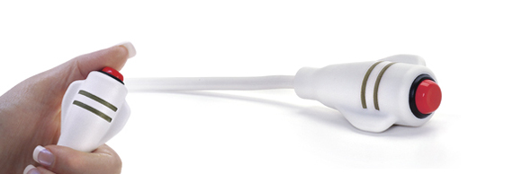
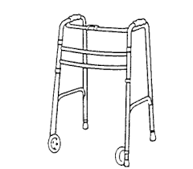
Preventing Falls
Nurse Call Bell
Falls Prevention
Ambulation Program
Notes:
Mobility and safety are a top priority for us. We get you up and moving same day you have your surgery. Although we encourage your independence, we want to be at your side at all times when you are moving from bed to chair, chair to bathroom and for all ambulation. You will have an alarm set on your bed so that if you forget and try to get up on your own the alarm will go off and your room will be swarmed by staff checking on your safety.
You will have a call bell at your side at all times and we encourage you to use it for all of your needs.
We have an ambulation program here at BMH in which we assist you with ambulation several times throughout the day. Frequent ambulation is encouraged to decrease pain, encourage circulation, and teach you proper mechanics and techniques that you will continue using at home. While in the hospital you will ambulate with a walker if you had your knee or hip replaced. You will continue using a walker at home, until you are ready to transition to crutches or a cane. Physical therapy will help you with the transition and when it is right for you.

Slide 20
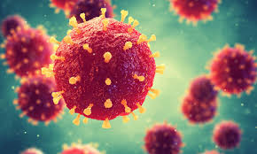
Preventing Infection
Pre-op DynaHex Wash
Avoid shaving and nail trimming
No jewelry in the OR
3 doses of IV antibiotics prophylactically
Vigilant hand hygiene
Daily dressing changes
Notes:
At BMH we pride ourselves on our extremely low infection post operative infection rate which stands at less than 1%. We are successful at this because of a number of factors

Slide 21
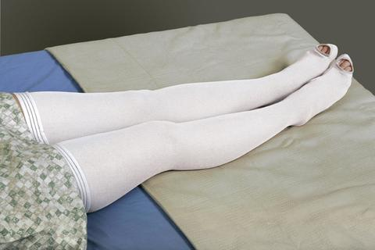



Preventing Blood Clots
SCDs (sequential compression devices)
TED stockings worn for 4 weeks post-op
knee high for Total Hip Replacements
thigh high for Total Knee Replacements
Increasing mobility
Aspirin 81mg TWICE a day for:
4 weeks post-op- Total knee and hip patients 2 weeks post-op- Total shoulder patients
*Unless on chronic anticoagulant*

Slide 22


Preventing Constipation
Bowel med regimen – stool softener, fiber, laxative
Decrease narcotics
Increase fluids
Diet rich in fiber
Ambulation

Slide 23
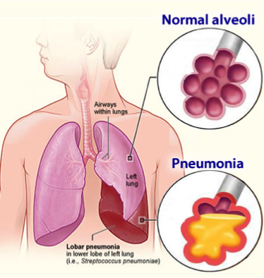
Preventing Pneumonia
Ambulation
Eating meals upright in chair, not in bed
Coughing & deep breathing exercises
Incentive spirometer for total shoulder patients

Slide 24
Day of Surgery
We will be assisting you to:
Begin PT exercises every hour while awake
Sit at edge of bed on evening of surgery
Out of bed to chair and ambulation in room/hallway, if surgery early enough in the day
Use bedpan/urinal/commode

Slide 25
Post-op Day 1 (Day after surgery)
Get out of bed for all meals with assist
Walk to bathroom and in hallway w/ assistance
Complete IV antibiotics and stop IV fluids
Change dressing
Ice/SCD’s
PT/OT – success w/ stairs, taught home exercises
Xray prior to discharge for all hips, knees, and shoulders (excludes anterior hips, done in OR)
Discharge home

Slide 26
Reminders…
Dental Clearance
Medical Clearance
Other Clearances as determined by providers (i.e. cardiac, oncology, hematology)
If needed, you will receive a call from Radiology to schedule your CT Scan
CT Scans are required for:
Total Knee Replacements
Total Hip Replacements (anterior approach)
Notes:
If you have not done so already please follow-up with your providers (i.e. primary care, dentist, and any specialist) regarding the required clearances. We will need to have all your clearances returned to the Orthopaedic office before your surgery. If you see a specialist like cardiology, oncology, hematology please make sure to obtain their clearances as well. If you have any questions regarding clearances please call the Orthopaedic office.
If you are having your knee replaced you will receive a call from our Radiology department to schedule additional imaging. A CT scan for all MAKO robotic knees and an MRI for Smith & Nephew knees, determined by your surgeon.

Slide 27
Reminders…
Get necessary equipment (walker, cane, crutches, raised toilet seat or commode, shower chair or bench)
Prepare your home (remove scatter rugs, meal prep, arrange for rides to appointments, animal care)
Make your outpatient physical therapy appointment
Ensure you have support after discharge, especially in the first 1-2 weeks following surgery and have a backup plan
Pick up post-op pain medication ahead of day of surgery
This prescription is typically sent in just prior to day of surgery
Notes:
So before your surgery be sure to:
1) get the equipment you will need;
2) make your appointment for outpatient PT today at the facility of your choice
3) have a back up plan!
It is always good to have options and a back up plan. So, for example, when you get home you may feel like the stairs to the bedroom look like Mt Monadnock so have someplace down stairs ready to sleep.
If you have animals and you think “I can manage feeding them/letting them out” - have someone available that can help you with your animals. It is always helpful to have help!

Slide 28

Our goal is to get you back home ASAP, prepared to safely care for yourself and be semi-independent.
Most of our patients go home the day after surgery!
Notes:
Most of our patients are up and moving the day of surgery and are ready to go home the day after surgery.

Slide 29
Benefits of going home quickly
You will be moving around more frequently and your new joint will feel better
You will get back to your normal routine quicker
Less exposure to institutional germs and therefore less risk of infection
A better outcome for your new joint!
Notes:
These are just a few of the benefits of going home quickly

Slide 30
Care Management
Care management nurses are available to help during your stay if needed for:
Obtaining equipment if you were unable to do so before surgery
Make a rehab referral if needed
Notes:
Should someone have difficulty after surgery or perhaps is not moving as well as we expected Care Management is available to help.
They can make referrasl to rehab if needed or help in getting equipment if you were unable to secure it prior to surgery.

Slide 31
BMH Physical Therapy
Kailey Crowell, DPT
Eileen Casey, PT
Kate Riley, PTA
Jeri-Lynn Atwood, PT
802-257-8255

Slide 32
Prepare your Home
Pick up scatter rugs, clear clutter
Move most commonly used items to within easy reach
Have a designated seat
Prepare meals ahead of time
Have loose, comfortable clothing available
Have an apron or bag to attach to walker
Notes:
Your time here in the hospital goes by very quickly so now is the time to prepare your house before you even have surgery.
After hip and knee surgery you will be using a walker so you want to pick up any scatter rugs and make sure that you have clear, easy pathways to walk around the house.
Because your mobility will initially be somewhat limited you want to have things that you use regularly to be in easy reach, that is typically between hip and shoulder height.
You will want to have a designated seat preferably a firm chair with arm rests, this is especially important for the total hip patients. Low, soft, squishy couches will be too hard to get up from after surgery.
If you are the cook in the house start preparing meals now and freeze them for later use. Right after surgery you won’t feel like standing in the kitchen prepping meals; have things available that you can easily reheat and serve.
Make sure you have loose comfortable clothing to wear. It is normal for your leg to be swollen after surgery and this may last for many weeks. Tight jeans/clothing will be too uncomfortable on your incision; so think about stretchy pants, shorts etc.
It can be helpful to tie a bag onto the walker so you can carry things from room to room.

Slide 33
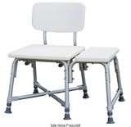
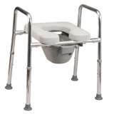
Activities of Daily Living/ Equipment Recommendations
A tub seat or bench is recommended
If you are taller than 5’2” you may need to raise the height of your toilet with a raised toilet seat or commode
A walker or crutches
Notes:
After surgery we recommend that you have a seat in the shower for safety. After surgery your balance will be a bit off at first, you’ll be using a walker, you may be taking pain meds that may make you feel a bit unsteady so that is why we recommend a seat in the wet, slippery environment of the shower.
You may also need to raise the height of your toilet seat. Just as low couch can be difficult to get up from a low toilet can also be problematic. If you are having a total hip w/ a posterior approach it is very important to raise the toilet height due to your hip precautions after surgery. You will only need these items for a brief period of time so it can be helpful to just borrow these items……

Slide 34
Equipment Sources
Places to borrow may include:
Guilford Cares – 802-579-1350
Dummerston Cares – 802-257-5800
Grafton Cares – 802-869-2674
Putney Cares – 802-387-5593
Valley Cares – 802-365-4115
Brattleboro Area Hospice – 802-257-0775
Westminster Cares – 802-722-3607
Family, friends, your church, VFW…
Notes:
Here is a list of some places that you may be able to get equipment on loan. Try to secure all the equipment that you will need BEFORE surgery so you won’t have to scramble to find items after your surgery.

Slide 35
Total Knee Patients
Active range of motion
Measure maximal flexion and extension while in OR (must work to maintain)
Flexion must stay >90 degrees
If unable to independently bend knee; use own hands to assist, use rolled towel or sheet to assist (it’s not cheating)
Must bend independently or w/ assistance 10X per hour
When out of bed in a chair, sit bent as much as possible, at least 90 degrees of flexion
When in bed, lay with leg in full extension (straight)
Knee replacement is not a spectator sport, requires active participation for great outcomes!

Slide 36
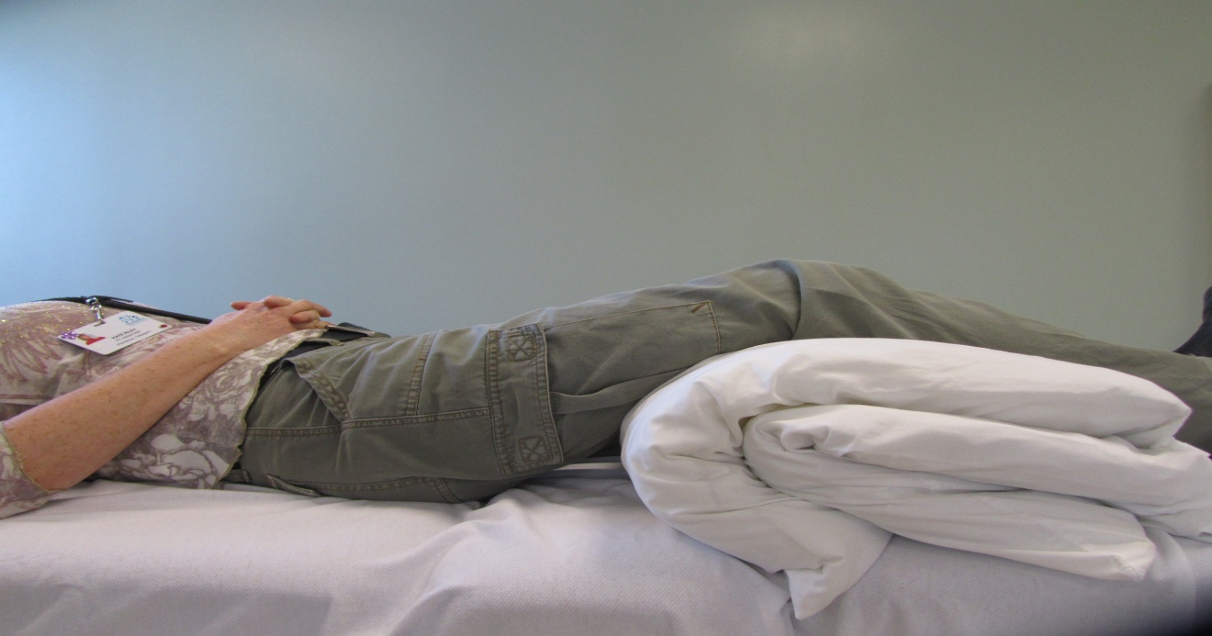
Total Knee Precautions
Avoid propping pillows under the knee(s)
Notes:
The total knees have it a little easier. The only thing that we don’t want you to do is prop pillows under the knee. We want you to work on getting the knee either fully straight or bending as much as possible. Having even just a little bend in your knee will cause you to have a limp and have ongoing pain in the knee so it is vital that you get it to straighten out fully.
It is very important that you move your knee as much as possible so you get good range of motion.
It may seem a little counter intuitive but moving your operated leg will actually help it feel better. When we have an injury our usual thing to do is rest and protect that body part but with a total joint surgery that will actually make you hurt MORE. Total joints like to move so we encourage to keep moving whenever you are awake.

Slide 37
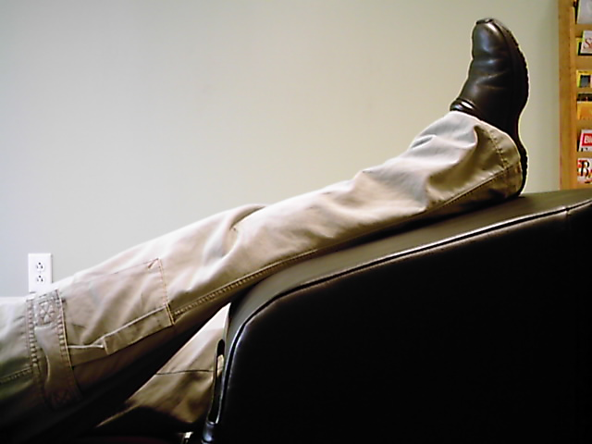
Proper elevation position for Total Knees
Notes:
When we talk about elevating your leg ideally we want your foot above your heart as shown.
You don’t need to buy anything special to do this; look around your house and improvise to get as close as possible to this.

Slide 38
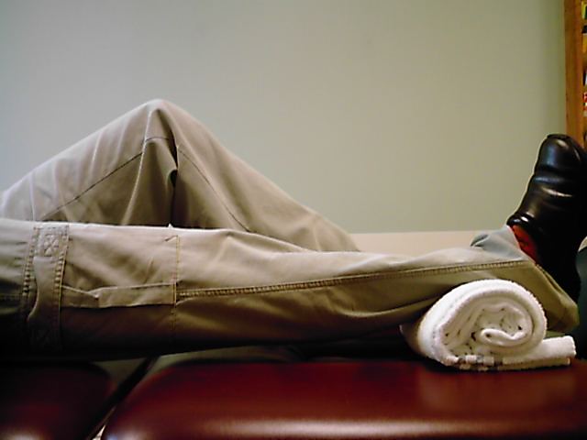
Heel Prop Position for Total Knees
Notes:
This is for the knee surgery patients to help get your knee to fully straighten out. Placing the heel up on something and then let gravity gradually stretch your knee fully straight.
Again it is very important that you get the knee fully straight after surgery!

Slide 39
Total Hip Patients
Dr. McLarney – Posterolateral approach
Avoid hip flexion >90 degrees, do not cross your legs, avoid internal rotation (3 month post-op precautions)
Dr. Gallagher and Dr. Kelley– Anterior approach
No post-op precautions

Slide 40
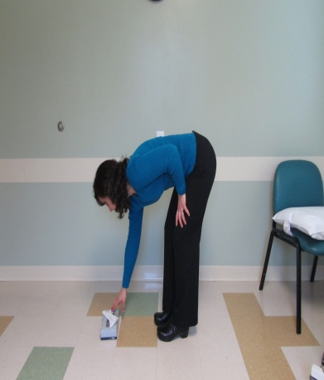
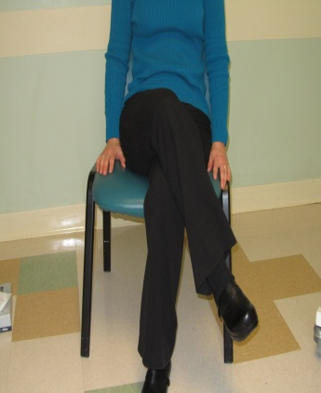
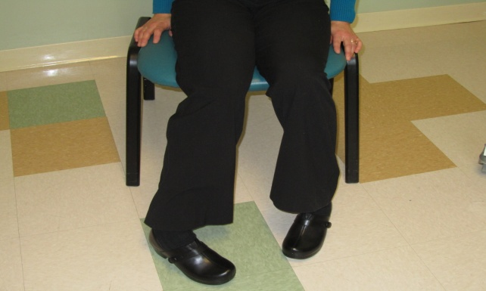
Total Posterior Hip Precautions
Avoid excessive hip flexion (knee toward chest)
Avoid adduction (leg towards center of body)
Avoid internal rotation (toes turned inward)
Notes:
These are the motions that we DON’T want you to do after posterior hip surgery.
DO NOT bend beyond 90 degrees
DO NOT cross your legs
DO NOT excessively rotate your leg. This may happen when you are walking and you turn around, DO NOT pivot on your operated leg. Pick up your feet and take steps to turn around.
We will remind you of all of this when you are here but it can be helpful to start thinking about it now and even practicing it.

Slide 41
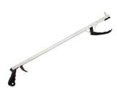
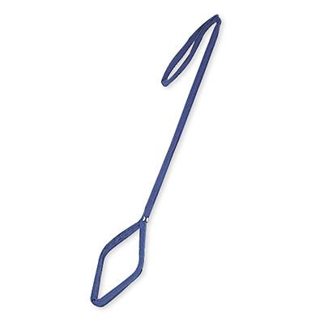
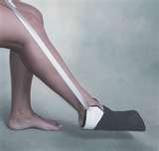
Other Helpful Items
Notes:
These items are for those folks who are having hip surgery with a posterior approach. The posterior approach has some precautions or movements that we don’t want you to do after surgery. One of those movements is bending forward. Occupational therapy will come and see you after your surgery to give you these devices and show you how to use them.

Slide 42
Total Shoulder Precautions
Use sling as instructed
Avoid extension of arm; have support under upper arm when lying down – want to be able to see your elbow at all times
Notes:
If you are having shoulder surgery you will be wearing a sling right after surgery and for about 10 days. To protect your surgery you want to be sure that you can see your elbow at all times even when laying down. We don’t want that arm to move towards your back. You will need to place a support under your arm when lying down so your upper arm remains at your side.

Slide 43
Total Shoulder Patients
Sleeping in semi-upright position may be most comfortable for short time
Bean bag chair on bed, recliner, lots of pillows
Avoid quick movements away from body
Use sling for comfort

Slide 44

Using a Walker
Push up from surface you are sitting on
Move walker, operated leg then your non operated leg to walk
Reach back for surface before sitting
Notes:
As I mentioned earlier, the hip and knee surgeries will be using a walker to walk after surgery.
When you are using a walker you should push up from whatever surface you are sitting on to stand up.
When you are ready to walk move the walker then the operated leg.
When you are ready to sit be sure to reach back to the chair to make sure you are close enough before you sit.
Ideally we like to have you use a walker with 2 wheels on the front because this gives you a more natural gait. Do not get the walkers w/ four wheels and a seat – they will be too fast for you right after surgery!
If you are unable to find one w/ 2 wheels that is OK, a standard walker will work OK too as you will not be needing it for very long.

Slide 45
After Surgery
Use your walker at home
Perform your home exercise program daily
Follow up with outpatient PT ASAP
No driving, swimming, hot tubs or baths until cleared by MD
Expect to be able to drive in 2-6 weeks
Notes:
After your surgery you will be using a walker at home. Most people can transition to a cane after about 1 week. It may be another couple of weeks until you can walk without any devices.
Before you leave here we will give you an exercise sheet. It is important that you do the exercises as instructed. As your joint has been wearing down you may not realize how weak some muscles may have become so it is important that you work toward building that strength back up again.
We want you to start outpatient PT as soon as possible. Ideally that would be the day after your discharge. You will need to make that appointment now – don’t wait until you are here to try and make an appointment. Most PT places have a wait list to get an appointment so be sure to make the appointment today to ensure you get the date that you need.
You will not be able to drive, swim, or soak in a tub until you are cleared. You have to have good strength and mobility in your operated leg and you must have stopped taking narcotic pain meds to drive.
Everyone is different as to when they can do that; expect anywhere from 2 to 6 weeks.
We want you to take a shower and wash you leg but we don’t want you soaking in tubs or swimming until your incision is entirely healed.

Slide 46
After Surgery Cont.
Continue to rest, ice and elevate operated extremity several times per day
No ointments or lotions directly on incision until incision is fully healed
Notes:
In outpatient PT one of the biggest complaints we hear is that you feel soooooo tired! Although you go home from the surgery very quickly this is still a big surgery for your body and it will take a lot of energy to heal.
In addition, many patients have difficulty sleeping at first after total joint surgery. As I said earlier the total joints like to move! So sleeping solidly for 6-8 hours is probably not going to happen right away, your sleep will be broken.
Most patients tell us that they had to get up and walk around the house, do their exercises, get fresh ice etc.
This will get better over the first few weeks but in the mean time take time during the day to prop up your leg, ice it and rest when you can. You will need to find a balance between rest and activity until your sleep normalizes and your energy returns.
Don’t put any ointments, lotions, or creams on your incision. Keep the incision clean and dry until your PT tells you otherwise.

Slide 47

Questions?

